Slide 1
Unix System Administration
Unit 16: file server
  samba

Slide 2
File server
Remote access to files
ftp
  put/get files from remote hosts
nfs
  tight integration in Unix environment
samba
  share access to/from Windows systems

Slide 3
Common Internet File System
other names
  Server Message Block (SMB)
  Samba
Samba server
  Linux system appear in Windows networks as if it were another Windows system
Samba client
  Linux can access Windows systems that are configured to share their resources

Slide 4
Common Internet File System
packages to install
  samba
  samba-common
  samba-client
smbfs is part of 2.6 kernel
  check for module, or compile in

Slide 5
Samba Client Utilities
smbclient
  command-line utility that allows logging into a Windows host, and interacting using a series of commands
standard mount command using a file system type of smbfs
printing to a Windows printer is done using the smbprint command

Slide 6
smbclient
check which shares are available
  smbclient –L host
  smbclient –L printers1
ftp-like file access
  smbclient //unix/faxes
parameter for user: -U user
  anonymous access might be allowed

Slide 7
smbfs
check whether module is available
use regular mount command
  mount //unix/faxes /mnt

Slide 8
Samba Server
Samba includes 2 server daemons:
  nmbd: NetBIOS name service
    winbindd: user/password resolver
  smbd: SMB protocol server
configuration: /etc/samba

Slide 9
configuration files
smb.conf
  defines shares
    home directories
    printers
    others
  check with testparm
lmhosts
  maps NETBios names to IP numbers
smbpasswd
  passwords for local users

Slide 10
Creating Samba Users
samba server requires user authentication
best practice: encrypted passwords
  create accounts for all users:
  cat /etc/passwd | mksmbpasswd.sh > smbpasswd
  create passwords for allowed users:
  smbpasswd user

Slide 11
Using SWAT to Configure SMB
web-based tool
  configure smb.conf
  start/stop smb service
  status information
install via: yum install samba-swat
SWAT runs via xinetd the superserver
  /etc/xinetd.d/swat

Slide 12
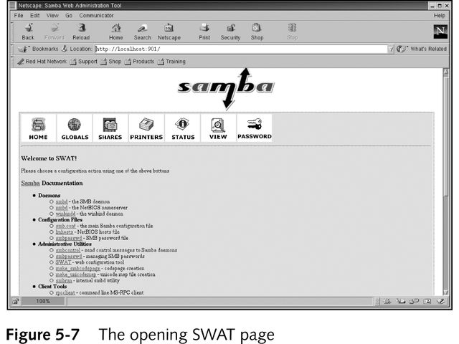
Using SWAT to Configure SMB

